Slide 1
CS M51A Discussion #2
Hyunjin Kim

Slide 2
Outline
Lecture Review
2-out-of-5 code
Homework#1 Review
Chapter 2
Example 2.18
One-set and Zero-set
Minterm and Maxterm
Conversion Simplified SOP ↔ POS

Slide 3
Ex2.18: A lock control
Input: CLASS ∈ {0, 1, 2, 3}
GROUP ∈ { A, B, C }
Output: LOCK ∈ { OPEN, CLOSED}
Function: LOCK
OPEN if CLASS≥2 and GROUP = A
CLOSE otherwise
->get a switching expression of Lock.

Slide 4
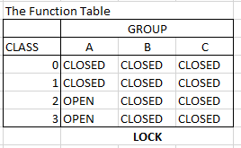
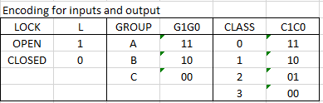

Slide 5
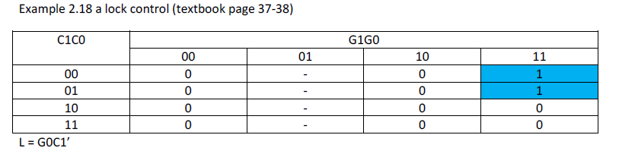
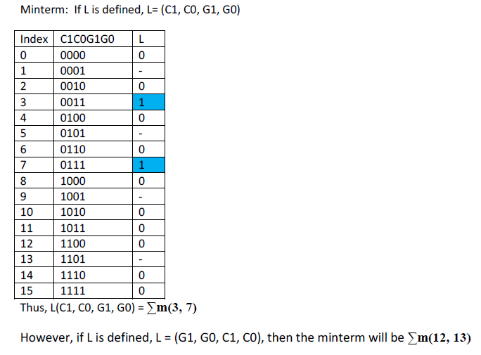
L=C1’C0’G1G0 + C1’C0G1G0
= C1’G1G0(C0’ + C0)
= C1’G1G0 -> simplified one by BA
Not, C1’G0 due to don’t care -> K-map

Slide 6
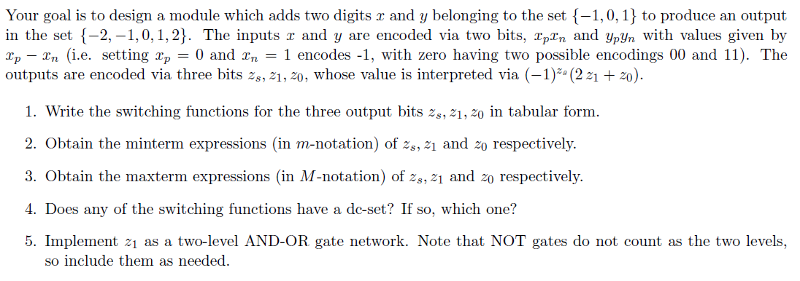

Slide 7

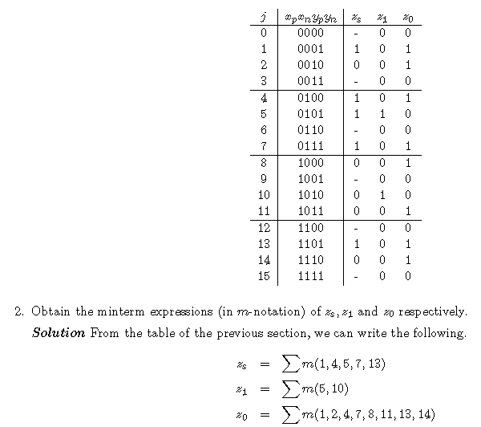

Slide 8
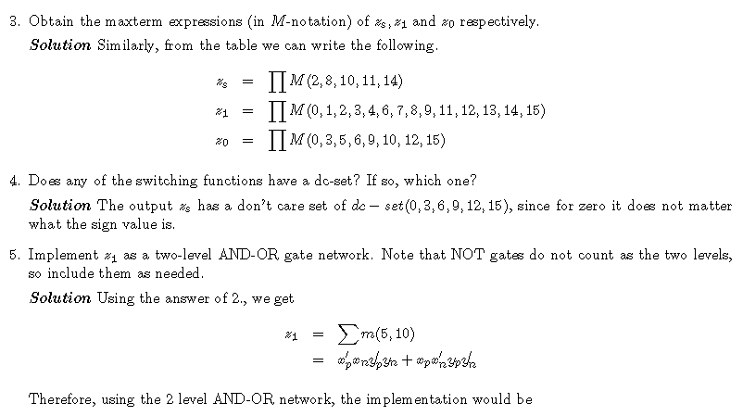
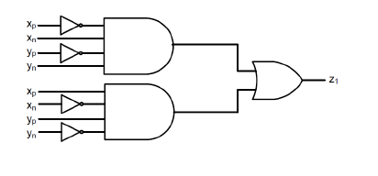

Slide 9
SOP ↔ POS
Single product term or Single sum term
SOP is same as POS vice-versa
Since there are interpreted in both ways.
Example
 | The term can be interperted either way.
 | SOP | POS
a | Single product | Single sum
ab | Single product | two sums
abc | Single product | three sums
abcd | Single product | four sums
a+b | two products | Single sum
a+b+c | three products | Single sum
b+c+d | three products | Single sum
a+b+c+d | four products | Single sum

Slide 10
SOP ↔ POS
Use distributive property more than single term
SOP -> POS
A+(BC) = (A+B)(A+C)
POS -> SOP
A(B+C) = AB + AC
Simplified SOP and its corresponding simplified POS
If don’t care exists, the conversion does not always work.
SOP | POS
ab + c | (a+c)(b+c)
ab+c+d =(a+c)(b+c)+d =(a+c+d)(b+c+d) | (a+c+d)(b+c+d)
ab+bc | (a+c)b
ab+bc+d =b(a+c)+d =(b+d)(d+(a+c)) =(b+d)(a+c+d) | (b+d)(a+c+d)

